Slide 1
Hardware Fundamental’s

Slide 2
TEAM MEMBERS
MONISHA S M
NANDINI N
ARVETI NAVEEN
MAHANTESH KUMBAR
T DIVYASRI
KL SAIKRISHNA

Slide 3
CONTENTS
INTRODUCTION
INPUT DEVICES
OUTPUT DEVICES
CPU
MEMORY
MOTHER BOARD
SMPS
STORAGE

Slide 4
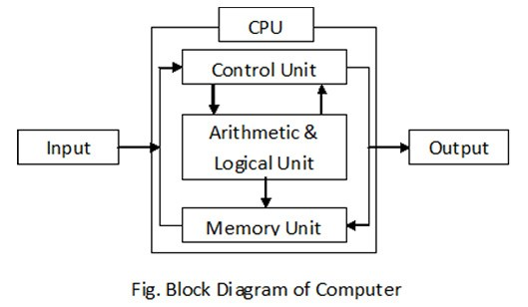
COMPUTER
A computer is an electronic machine that manipulates data according
to a set of instructions and data.
Software
Hardware

Slide 5
INPUT DEVICES
An input device is any hardware device that sends data to a computer, allowing you to interact with and control it.
Examples:
Keyboard
Mouse
Scanner
Joystick
Barcode Reader

Slide 6
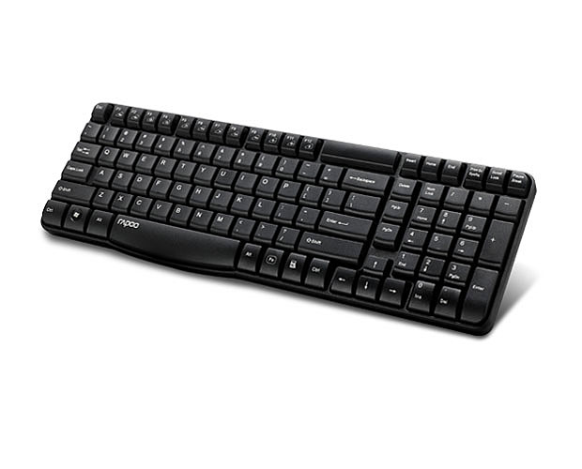
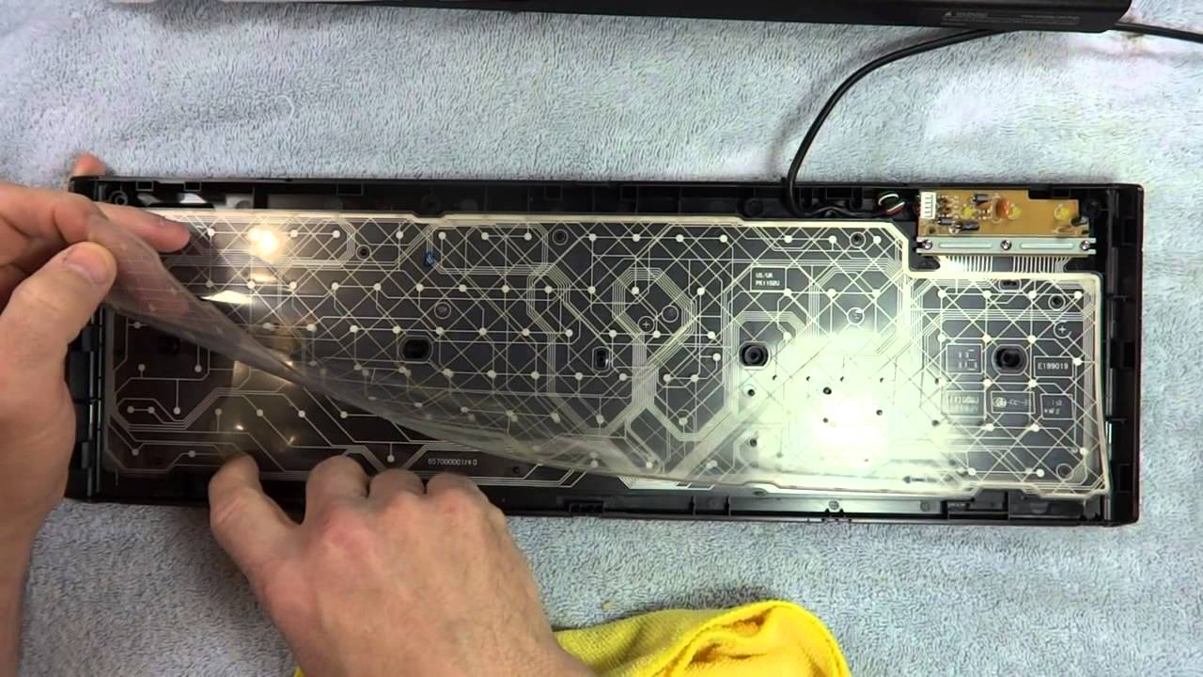
KEYBOARD
The keyboard is the piece of computer hardware used to input text, characters, and other commands into a computer or similar device.

Slide 7
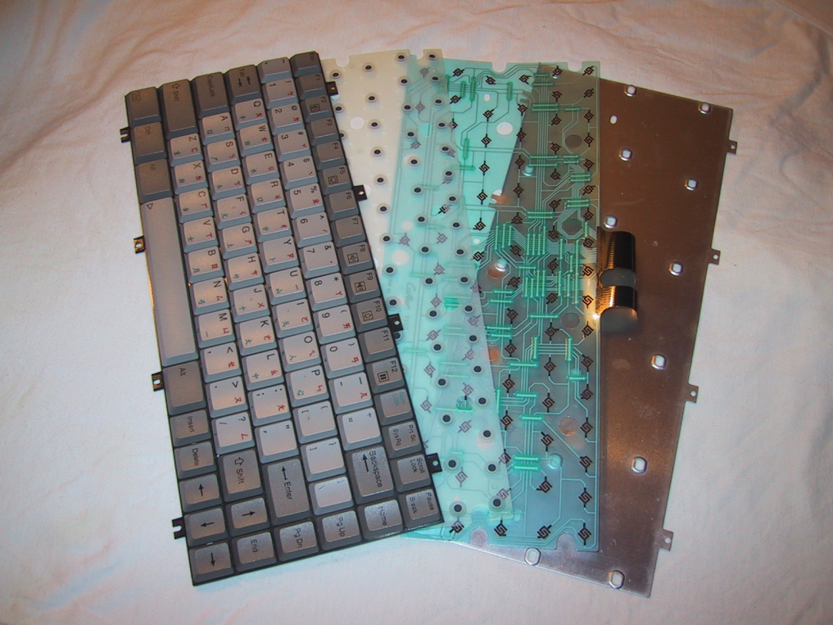
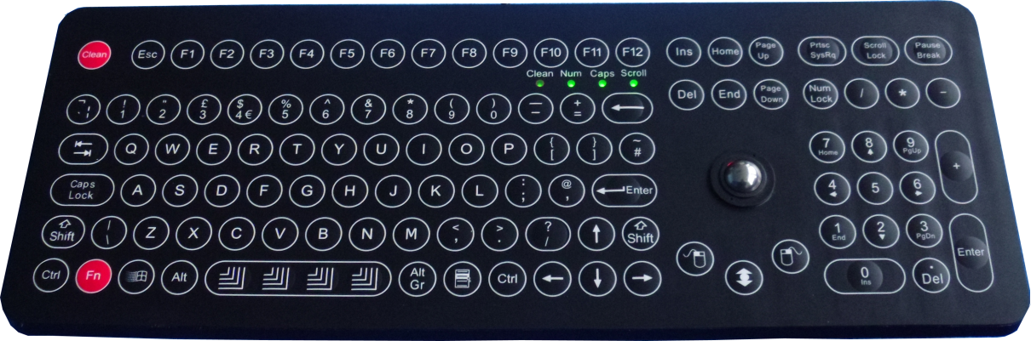
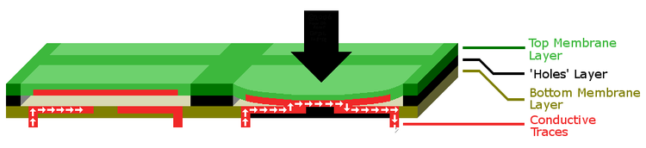
TYPES OF KEYBOARD
Mechanical keyboard Membrane keyboard

Slide 8
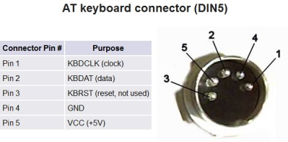
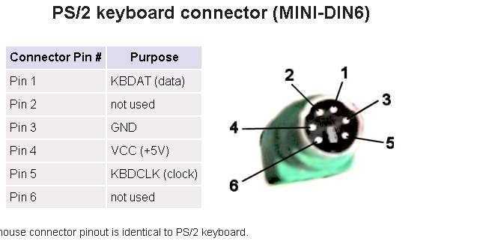
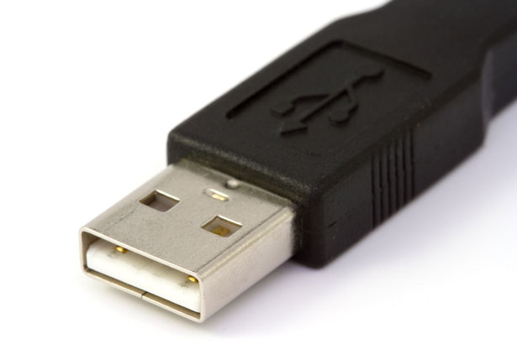
KEYBOARD CONNECTOR AND DETAILS.

Slide 9
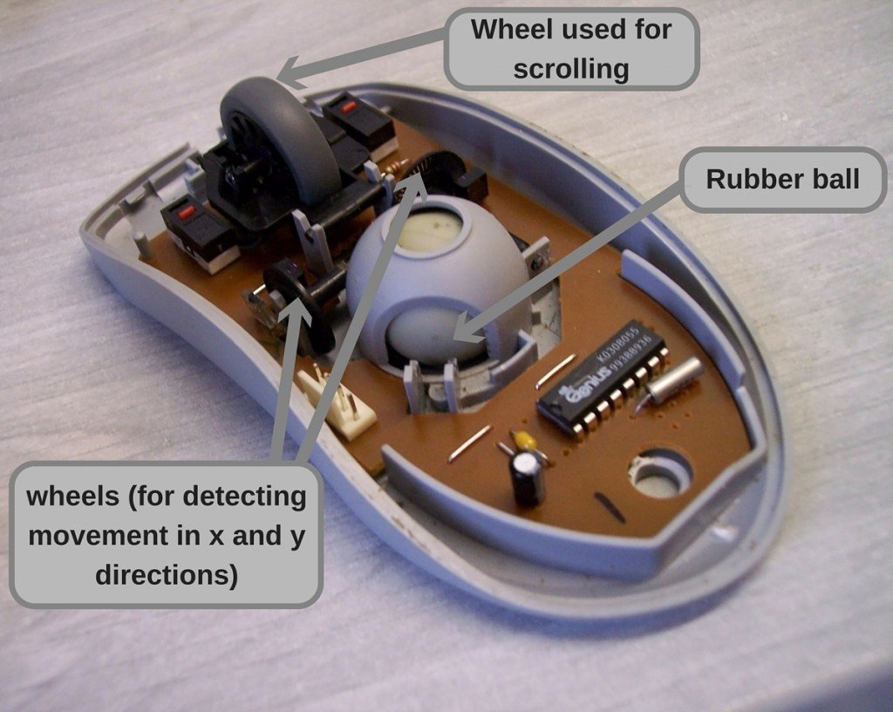
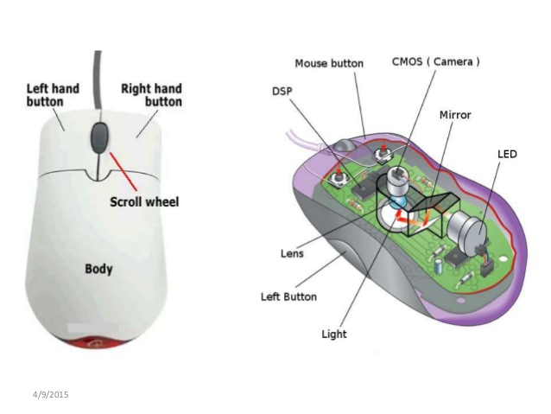
MOUSE
The mouse is a computer input device used to move a cursor around a screen. The mouse buttons are used to interact with whatever is being pointed at.
Mechanical mouse.
Optical mouse.

Slide 10
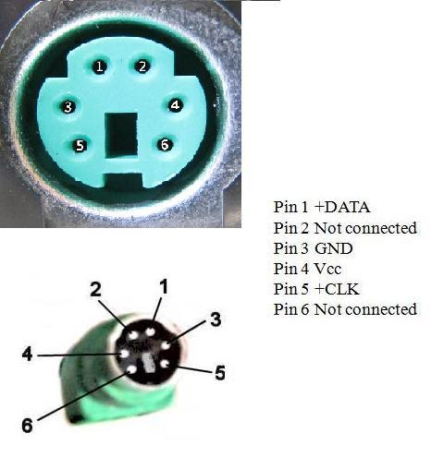
Mouse Connector Pins And Details

Slide 11
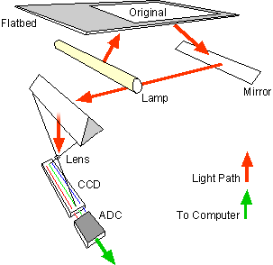
SCANNERS
A scanner is a device that captures images from photographic prints, posters, magazine pages, and similar sources for computer editing and display.
Flatbed scanner

Slide 12
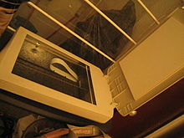
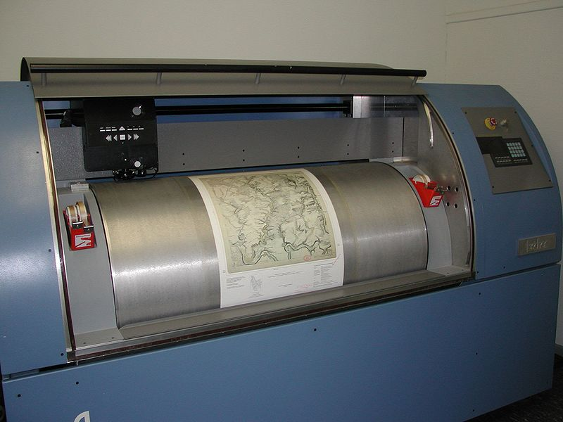
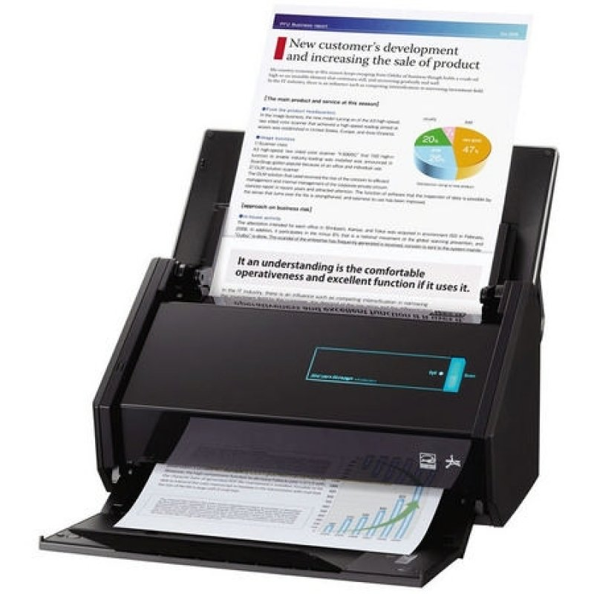
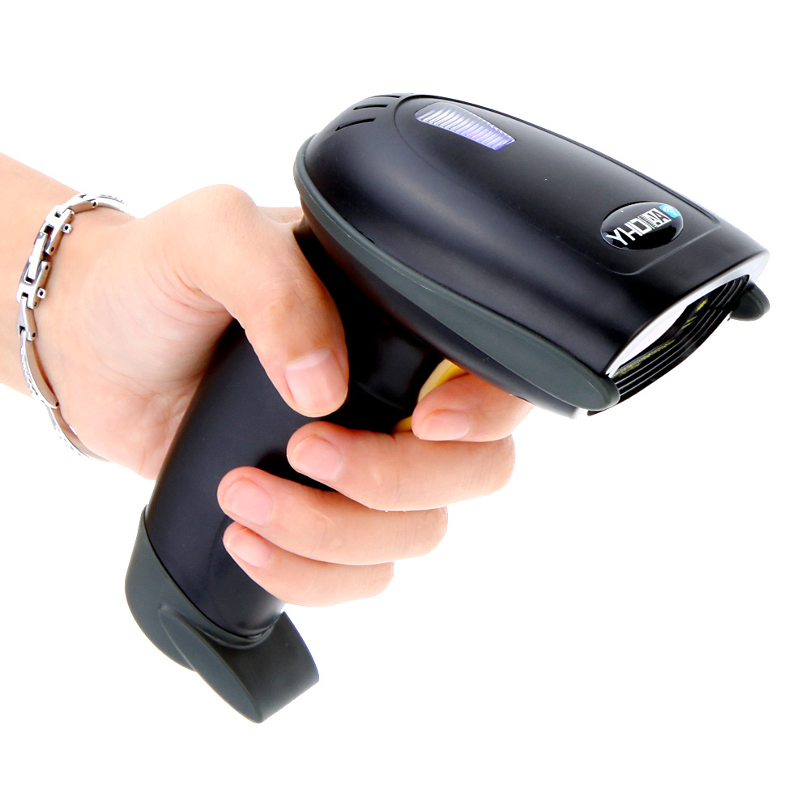
Types of Scanners
Flatbed Scanner
Drum Scanner
Sheet Fed Scanner
Handheld Scanner

Slide 13
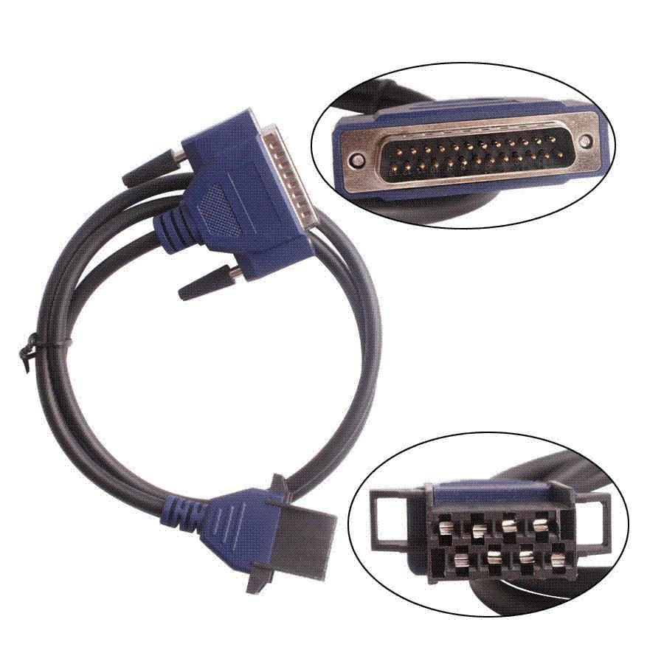
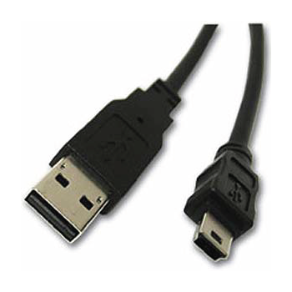
Connectors for Scanner

Slide 14
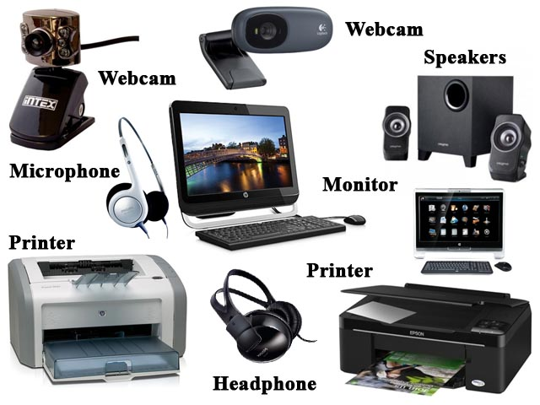
OUTPUT DEVICES
An output device is any device used to send data from a computer to another device or user.
Examples:
Monitors
Projectors
Speakers
Headphones
Printers

Slide 15
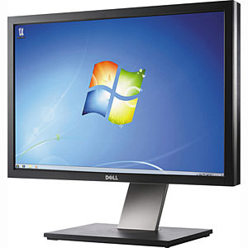
Monitors
The monitor displays the computer's user interface and open programs, allowing the user to interact with the computer, typically using the keyboard and mouse.
TYPES OF MONITORS:
CRT Monitors
LCD
LED

Slide 16
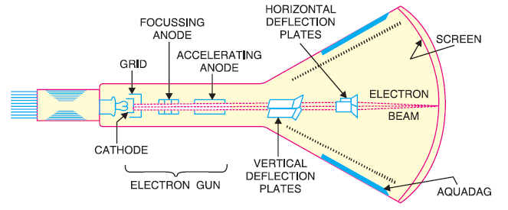
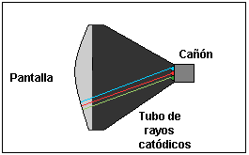
CRT Monitors

Slide 17
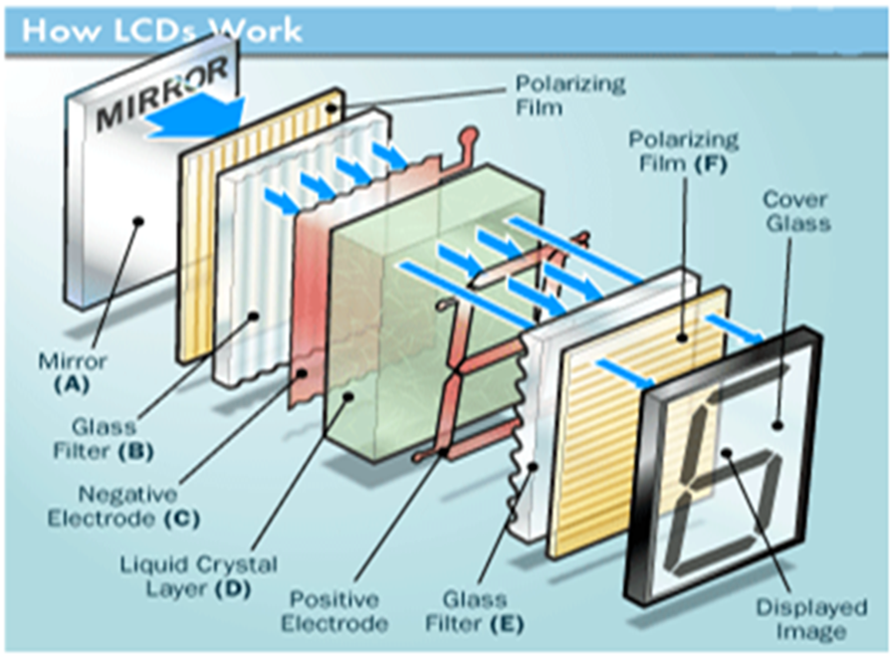
LCD – Liquid crystal Display

Slide 18
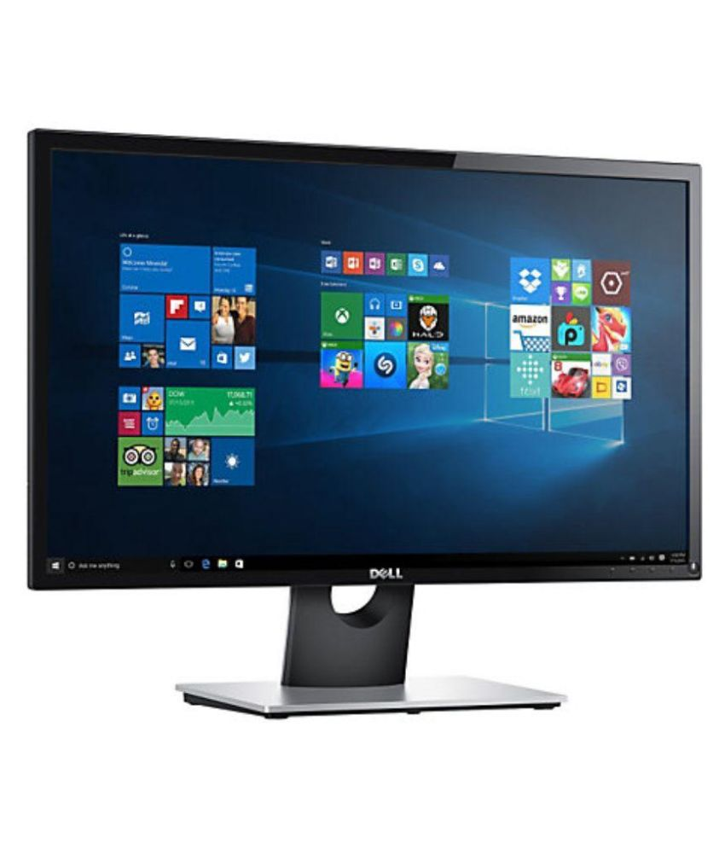
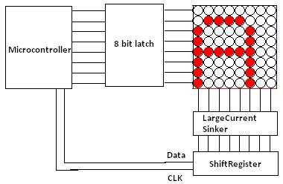
LED Monitors – Light Emitting Diode
An LED Monitors is a flat panel display which uses an array of light-emitting diode as pixels for a video display.

Slide 19
PRINTERS
A printer is a device that accepts text and graphic output from a computer and transfers the information to paper, usually to standard size sheets of paper.
TYPES OF PRINTERS
DOT MATRIX
INK JET
LASER PRINTER

Slide 20
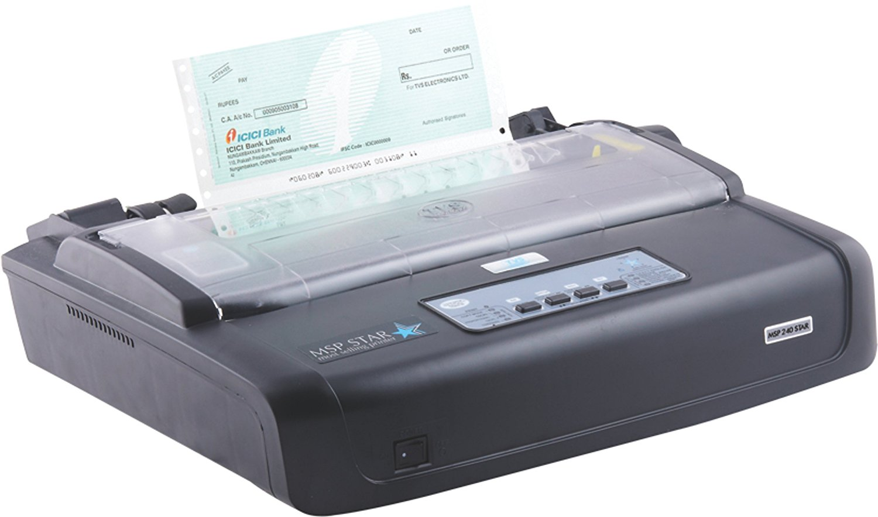
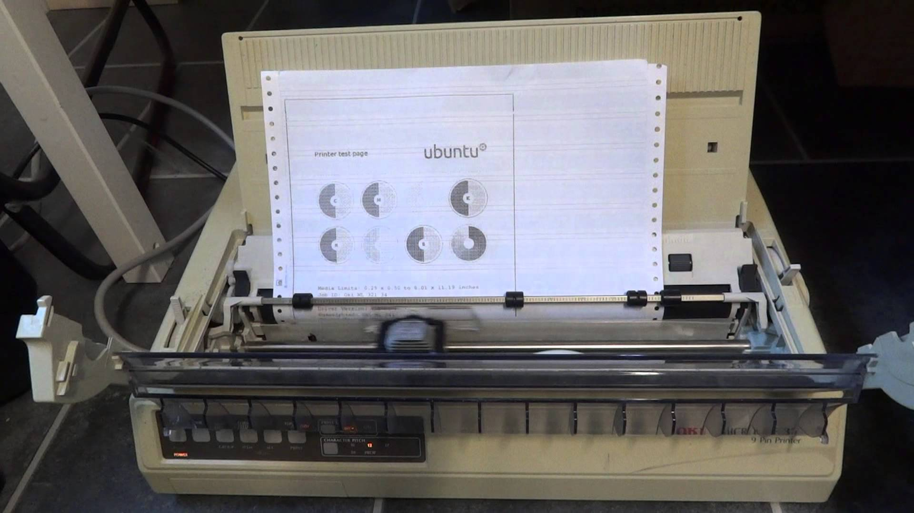
DOT MATRIX PRINTER
A dot matrix printer is an impact printer that prints using a fixed number of pins or wires.

Slide 21
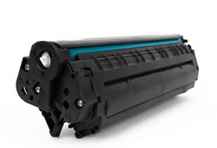
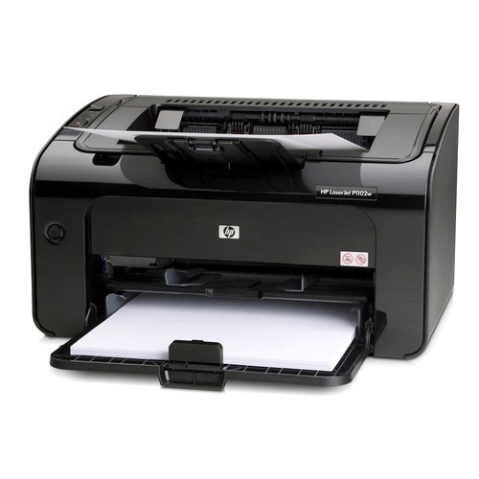
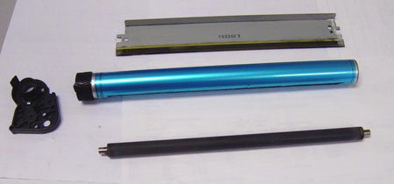
LASER PRINTER
Laser printing is an electrostatic digital printing process. It produces high-quality text and graphics.
Printer
Cartridge
Drum,MagneticRod,
DoctorBlade

Slide 22
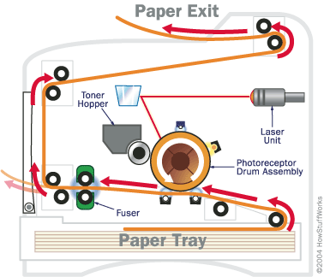
LASER PRINTER
Laser printing is an electrostatic digital printing process. It produces high-quality text and graphics

Slide 23
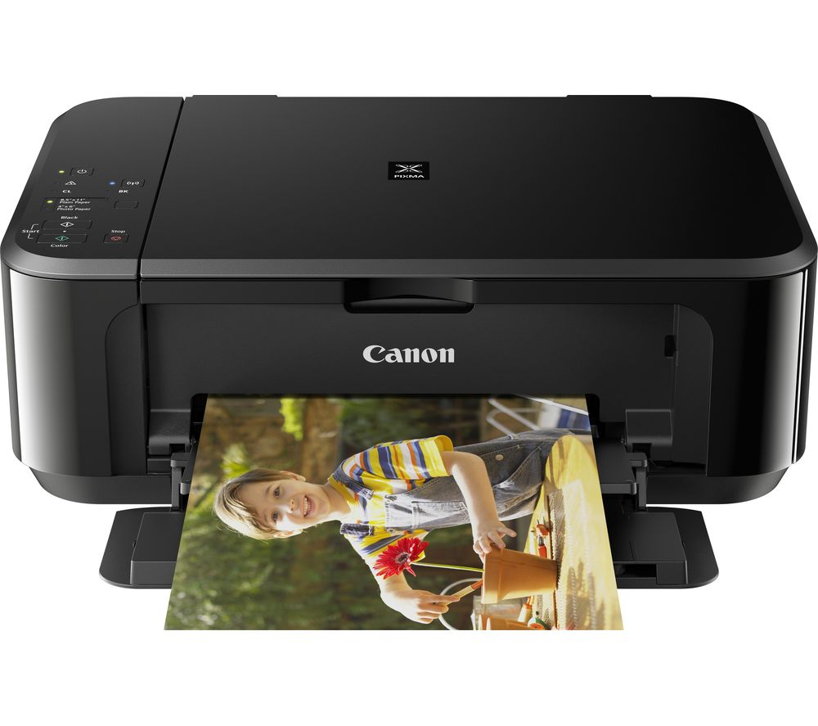
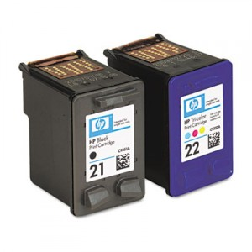
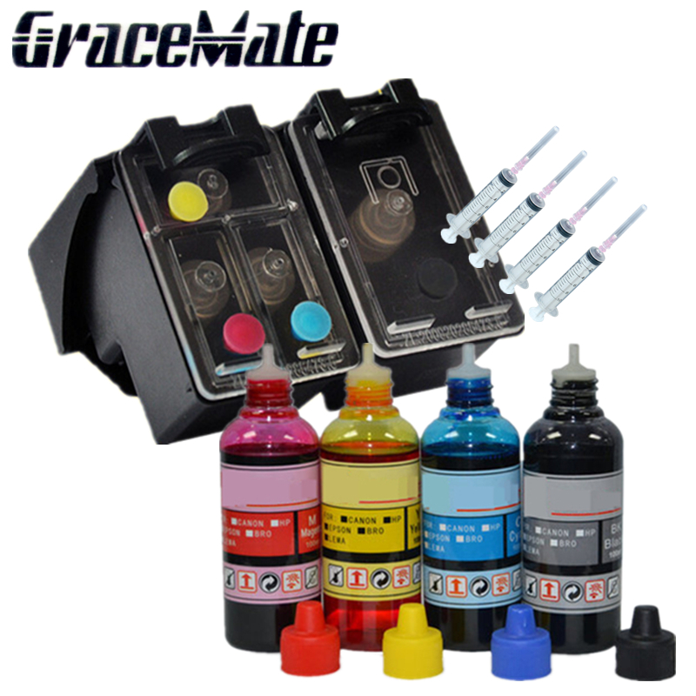
INK JET PRINTERS
An inkjet printer is a computer peripheral that produces hard copy by spraying ink onto paper.

Slide 24
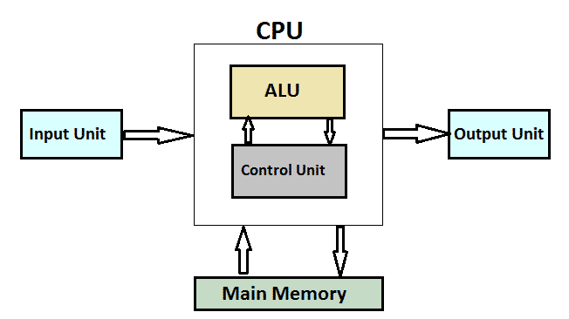
CPU:
A central processing unit (CPU) is the electronic circuitry within a computer that carries out the instructions of a computer program by performing the basic arithmetic, logical, control and input/output (I/O) operations specified by the instructions.

Slide 25
Program counter(PC):
It is an incrementing counter that keeps track of the memory address of the instruction that is to be executed next.
Accumulator:
An accumulator is a register in which intermediate arithmetic and logic results are stored.
Clock Speed:
Also called clock rate, the speed at which a microprocessor executes instructions. Every computer contains an internal clock that regulates the rate at which instructions are executed and synchronizes all the various computer components

Slide 26
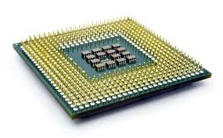
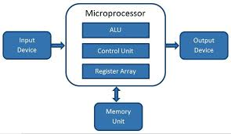
MICROPROCESSORS
Microprocessor is an integrated circuit that contains all the functions of a central processing unit of a computer and it is Made up of silicon(semi conductor).

Slide 27
Versions of Micro processors
MICROPROCESSOR | PRODUCTION YEAR | BIT | SPEED
INTEL 4004 | 1971 | 4 bit | 740KHz
INTEL 4040 | 1974 | 4 bit | 500
INTEL 8008 | 1972 | 8 bit | 500KHz
INTEL 8080 | 1973 | 8 bit | 2MHz
INTEL 8085 | 1975 | 8 bit | 3MHz
INTEL 8088 | 1979 | 16 bit | 5MHz
INTEL 80186 | 1982 | 16 bit | 6MHz
INTEL 80286 | 1983 | 16 bit | 8MHz
INTEL 80386 | 1986 | 32 bit | 16MHz
INTEL 80486 | 1989 | 32 bit | 16MHz
PENTIUM | 1993 | 32 bit | 60MHz
PENTIUM PRO | 1995 | 32 bit | 200MHz
PENTIUM II | 1997 | 32 bit | 450MHz
PENTIUM III | 1999 | 32bit | 1.4GHz
PENTIUM IV | 2000 | 64 bit | 3.8GHZ

Slide 28
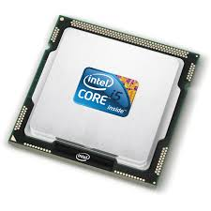
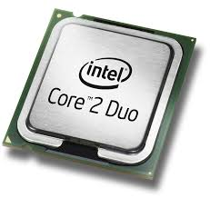
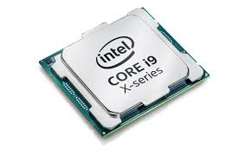
Types of core
Dual core microprocessor
Quad core microprocessor
Octal core microprocessor
Hexa core microprocessor

Slide 29
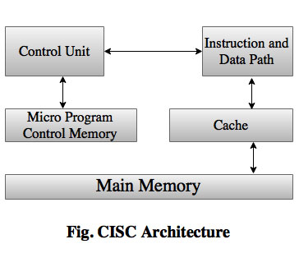
CPU Architecture
CISC Architecture:

Slide 30
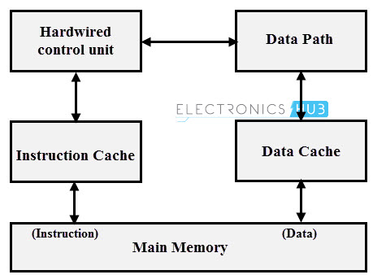
RISC Architecture:

Slide 31
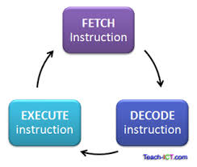
OPERATIONS
Fetch: The next instruction is fetched from the memory address that is currently stored in the program counter and stored into the instruction register.
Decode: The encoded instruction present in the instruction register is interpreted by the decoder.
Execute: The control unit of the CPU passes the decoded information as a sequence of control signals to the relevant function units of the CPU to perform the actions required by the instruction.

Slide 32
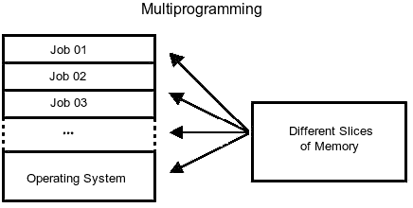
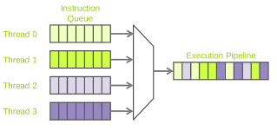
MULTIPROGRAMMING:
PARALLELISM:
In a multiprogramming system there are one or more programs loaded in main memory which are ready to execute.
MULTITHREADING:
Multithreading is the ability of a CPU to execute multiple processes or threads concurrently.

Slide 33

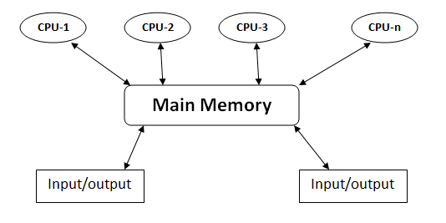
MULTITASKING:
Multitasking is the concurrent execution of multiple tasks over a certain period of time.
MULTIPROCESSING:
The term also refers to the ability of a system to support more than one processor or the ability to allocate tasks between them.

Slide 34
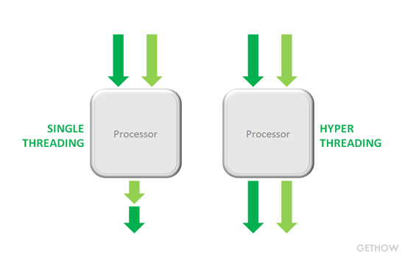
HYPER THREADING:
It allows a single microprocessor to act like two separate processors to the operating system and the application programs that use it.

Slide 35
MEMORY
Computer memory is any physical device capable of storing information temporarily or permanently. For example, Random Access Memory (RAM), is a volatile memory that stores information on an integrated circuit used by the operating system, software, and hardware.

Slide 36
Types of memory:
Memory is primarily of three types. They are
Cache memory
Primary memory/Main memory
Secondary memory

Slide 37
Primary memory:
Primary memory holds only those data and instructions on which the computer is currently working. It has a limited capacity and data is lost when power is switched off.
It is generally made up of semiconductor device.
It is divided into two subcategories RAM and ROM.

Slide 38
Secondary Memory
This type of memory is also known as external memory or non-volatile. It is slower than the main memory.
These are used for storing data/information permanently.
The contents of secondary memories are first transferred to the main memory, and then the CPU can access it.
For example, disk, CD-ROM, DVD, etc.

Slide 39
ROM(Read Only Memory)
Read only memory(ROM) as the word refers mainly it can only read the data which is stored in it. This memory is mainly used by our computer when we just turn on our computer. It contains BIOS of system. This is non-volatile in nature.
Types of ROM:
PROM
EPROM
EEPROM

Slide 40
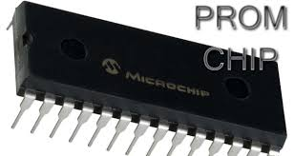
PROM(Programmable Read Only Memory):
In this when the data is stored then we have no right to change or alter any data to it.
In this the data is written by manufacturer company, even you can also purchase blank PROM chip but it can be programmed by special tool such as PROM programmers
In general PC’s mainly PROM is used because we don’t have to alter any date to it.

Slide 41
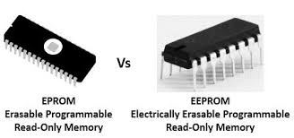
EPROM(Erasable PROM):
The word “Erasable” means we can change or erase the data, so in EPROM we have right to change the data.
In this we can change the data with the help of ultra violet rays.
EPROM is much expensive than PROM.
EEPROM(Electrically Erasable PROM):
It is a type of ROM which can be erased by electrical charges.
EEPROM can be erased one byte at anytime rather than erasing the entire chip by ultra violet rays.

Slide 42
RAM(Random Access Memory)
RAM stores the data which the user currently uses are as we say it stores the data temporarily in it.
Ram needs power or electricity to work, when the computer power is turned off then all the data in it will be erased automatically. This is the circuit which have its separate slot in mother board. This allows the computer to run the software faster.
Types of RAM:
SRAM
DRAM

Slide 43
SRAM(Static RAM):
The word “Static” refers that the memory retains its contents as long as the power is supplied so that’s why we can say this is volatile in nature.
SRAM does not need to be refreshed periodically.
SRAM is faster but more expensive than DRAM.
SRAM is made up of Transistors.
DRAM(Dynamic RAM):
It contains data only when electricity is available.
DRAM needs to refreshed periodically due to this, this RAM works slower than SRAM.
Mainly general PC uses this RAM because it is much cheaper than SRAM and requires less space.DRAM is made up Capacitors.

Slide 44
Types of DRAM:
DDR 1: The next generation of SDRAM is DDR, which achieves greater bandwidth than the preceding single data rate SDRAM by transferring data on the rising and falling edges of the clock signal (double pumped). Effectively, it doubles the transfer rate without increasing the frequency of the clock. The transfer rate of DDR is between 266~400 MT/s. DDR266 and DDR400 are of this type.
DDR2:Its primary benefit is the ability to operate the external data bus twice as fast as DDR SDRAM. This is achieved by improved bus signal.DDR2 memory is at the same internal clock speed (133~200MHz) as DDR, but the transfer rate of DDR2 can reach 533~800 MT/s with the improved I/O bus signal. DDR2 533 and DDR2 800 memory types are on the market.
DDR3:DDR3 memory reduces 40% power consumption compared to current . The transfer rate of DDR3 is 800~1600 MT/s. They can make the memory control the refresh rate according to the temperature variation.

Slide 45

CACHE MEMORY
Cache memory, also called CPU memory.
It is random access memory (RAM) .
Computer microprocessor can access more quickly than it can access regular RAM.
This memory is typically integrated directly with the CPU chip or placed on a separate chip that has a separate bus interconnect with the CPU.
This memory contains more frequently used data.

Slide 46
Types of cache memory:
L1 cache:
A memory bank built into the CPU chip, Also known as primary cache
It is the fastest memory in the computer and it is closest to microprocessor.
L2 cache memory is present on a separate chip. That means it is a expansion card that can be quickly accessed than main memory.
L2 cache:

Slide 47

MOTHERBOARD
A motherboard is the main printed circuit board (PCB) in a computer.
The motherboard is a computer’s central communications backbone connectivity point, through which all components and external peripherals connect.

Slide 48

TYPES OF MOTHERBOARD:
At Motherboard:
The oldest of the main boards, these motherboards were used in earlier 286/386 or 486 computers.
The AT means the board consists of advanced technology(AT) power connectors.
There are two power connectors of 6 pin each mounted on the AT motherboards.
The AT motherboards were available in the early 80’s.

Slide 49

ATX MOTHERBOARD:
The ATX motherboards started in 90’s and are still available.
The ATX connector on the motherboard consists of a single connector.
These boards are used for P2/P3 or P/4 processors.
Motherboard for P1/P2 processors

Slide 50

NORTH BRIDGE AND SOUTH BRIDGE
NORTH BRIDGE:
Northbridge is an Intel chipset that communicates with the computer processor and controls interaction with memory, the Peripheral Component Interconnect (PCI) bus, Level 2 cache, and all Accelerated Graphics Port (AGP) activities.
SOUTH BRIDGE:
Southbridge is an Intel chipset that manages the basic forms of input/output ( I/O ) such as Universal Serial Bus ( USB ), serial , audio, Integrated Drive Electronics ( IDE ), and Industry Standard Architecture ( ISA ) I/O in a computer

Slide 51
MEMORY MODULES
SIMM
A SIMM (single in-line memory module) is a module containing one or several random access memory (RAM) chips on a small circuit board with pins that connect to the computer motherboard.
DIMM
A DIMM (dual in-line memory module) is a double SIMM (single in-line memory module).
RIMM
The memory module used with RDRAM chips. It is similar to a DIMM package but uses different pin settings

Slide 52
SOCKETS
LGA – Land Grid Array
The land grid array (LGA) is a type of surface-mount packaging for integrated circuits (ICs) that is notable for having the pins on the socket (when a socket is used) rather than the integrated circuit.
Introduced by Intel.
Some LGA sockets
LGA 775 LGA 1156
LGA 1155 LGA 1366

Slide 53
PGA – PIN GRID ARRAY
A CPU socket is made of plastic, and comes with a lever or latch.
There is metal contacts for each of the pins or lands on the CPU.
Many packages are keyed to ensure the proper insertion of the CPU.
CPUs with a PGA (pin grid array) package are inserted into the socket and the latch is closed.
Introduced by AMD.

Slide 54
BUS
In computer architecture, a bus is a communication system that transfers data between components inside a computer, or between computers.
Types of BUS :
Address BUS
An address bus is a computer bus architecture used to transfer data between devices that are identified by the hardware address of the physical memory (the physical address), which is stored in the form of binary numbers to enable the data bus to access memory storage.
Data BUS
A data bus is a system within a computer or device, consisting of a connector or set of wires, that provides transportation for data.

Slide 55

EXPANSION SLOTS
PCI
PCI - PCI is the initialism for Peripheral Component Interconnect and is part of the PCI Local Bus standard.
Introduced by INTEL in the year 1992.
PCI comes with both 32 bit and 64 bits.
Used to attach the hardware to computer(motherboard).

Slide 56
ISA – Industry Standard Architecture
Introduced by IBM and headed by Mark Dean.
16 BIT Internal bus.
ISA was originally 8 BIT computer slot, later expanded to 16 bits.
ISA allowed to create peripherals and actual Interface.
In 1993 Microsoft introduced a PnP ISA slot that allowed to computer to automatic detection and setup for peripherals.

Slide 57
CNR - Communications and networking riser
CNR was Introduced by Intel(Feb 7, 2000).
Used for Specialized Networking.
It allows you to deals with audio, networking or modem.
Commonly found on Pentium IV.
Physically a CNR slot has two rows of 30 pins, with two possible pin configurations.
CNR type A – Uses 8 pins.
CNR type B – Uses 17 pins (MII).

Slide 58
EISA – Extended Industry Standard Architecture
A standard Bus for IBM computers.
It was introduced in September 1998.
It is a superset of ISA.
EISA extends the AT Bus.
This slot allows us to share the BUS.
(Means more than one CPU can access same Bus)

Slide 59

AGP - Accelerated Graphics Port
An earlier hardware interface from Intel for connecting a graphics card (display adapter) to a PC.
This is a graphics card expansion port designed by Intel that resides on the motherboard of a computer.
PCI graphics ports typically run at 33 MHz and have a maximum transfer rate of 132 MB/sec.

Slide 60
PERIPHERAL COMPONENT PORTS
Serial port
A serial port is a serial communication interface through which information transfers in or out one bit at a time.
Parallel port
A parallel port is a type of interface found on computers (personal and otherwise) for connecting peripherals. Parallel ports send multiple bits of data at once, in parallel communication, as opposed to serial interfaces that send bits one at a time.
USB: An external bus standard that supports data transfer rates of 12 Mbps. A single USB port can be used to connect up to 127 peripheral devices, such as mouse, modems, and keyboards.
Video connector: Video connectors are electrical connectors - plugs and sockets - for carrying video signal.

Slide 61

BIOS(Basic Input / Output System)
BIOS (basic input/output system) is the program a personal computer's microprocessor uses to get the computer system started after you turn it on.
It also manages data flow between the computer's operating system and attached devices such as the hard disk, video adapter, keyboard, mouse and printer.

Slide 62

CMOS
Complementary Metal-Oxide Semiconductor
CMOS is an on-board, battery powered semiconductor chip inside computers that stores information.
This information ranges from the system time and date to system hardware settings for your computer.

Slide 63
WHAT IS SMPS?
SMPS-Switch Mode Power Supply
Provides Power to the electrical load and involves some kind of switching actions.
SMPS = convert unregulated AC to regulated DC.
It converts power from a source, to a load while converting voltage and current.

Slide 64
BASIC BLOCKS OF SMPS
AC
Transformer
Rectifier
Filters
Regulators
DC
Switch Mode

Slide 65
SMPS CONNECTORS AND ITS TYPES
SMPSs are three types:
1. AT SMPS(Advanced Technology)-12 pin power connector.
2. ATX SMPS(advanced Technology extended)-20 pin power connector.
3. BTX SMPS(Balanced Technology extended)- 24 pin power connector.

Slide 66

EARTHING
The process of transferring the immediate discharge of the electrical energy directly to the earth by the help of the low resistance wire is known as the earthing.

Slide 67
STORAGE
Storage is a mechanism that enables a computer to retain data, either temporarily or permanently.
Storage may also be referred to as computer data storage or electronic data storage.
Types of Storage:
Storage is among the key components of a computer system and can be classified into several forms, although there are two major types:

Slide 68
Volatile storage:
Requires a continuous supply of electricity to store/retain data.
It acts as a computer's primary storage for temporarily storing data.
Examples of volatile storage include hard disk, USB storage and optical media.
Non-Volatile Storage:
A type of storage mechanism that retains digital data even if it’s powered off or isn’t supplied with electrical power.
This is often referred to as a secondary storage mechanism, and is used for permanent data storage.
Examples of non-volatile storage include cache memory and random access memory (RAM).

Slide 69

Hard Disk
A hard disk is a data storage device.
that uses magnetic storage to store and retrieve digital information using one or more rigid rapidly rotating disks coated with magnetic material.

Slide 70

Internal View of Hard Disk

Slide 71
Partitioning in Hard Disk
Creation of one or more regions on a Hard Disk.
Also known as Hard Disk Slicing.
There are two types of partitioning methods
1. Simple Partition
2. Dynamic Partition

Slide 72
Simple Partition Method
MBR – Master Boot Record
GPT – GUID Partition Table
(Globally Unique Identification)

Slide 73
Dynamic Partition
Simple Volume
Spanned Volume
Stripped Volume
Mirrored Volume
RAID - 5

Slide 74
HardDisk Interfaces
IDE(Integrated drive electronics)
It is used between a computer mother board data and the computer disk storage devices
It is physical interface used for connecting storage devices
SCSI(Small Computer System Interface)
Its is storage technology that has made a name for itself as a ,high performance, high reliable
Increasing demands for speed and flexibility in storage devices.
SCSI is most commonly used for hard disk drives and tape drives.

Slide 75
SATA(Serial advanced technology attachment)
It connects to some storage devices such as hard disk drives, optical drives.
Transfer rates for Serial ATA begin at 150MBps.
PATA(Parallel advanced technology attachment)
It is an interface standard for the connection of storage devices such as hard disk drives, floppy disk drives, and optical disc drives in computers.
Parallel ATA cables have a maximum allowable length of 18 in (457 mm). Because of this limit, the technology normally appears as an internal computer storage interface.

Slide 76

CD-ROM
"Compact Disc Read-Only Memory". Computers can read CD-ROMs, but cannot write to CD-ROMs, which are not writable or erasable.
The CD-ROM format was developed by Japanese company Denon in 1982.

Slide 77
COMPONENTS OF CD-ROM
The drive consists of three fundamental components:
A drive motor spins the disc. This drive motor is precisely controlled to rotate between 200 and 500 rpm depending on which track is being read.
A laser and a lens system focus in on and read the bumps.
A tracking mechanism moves the laser assembly so that the laser's beam can follow the spiral track. The tracking system has to be able to move the laser at micron resolutions.

Slide 78

MAGNETIC TAPE
Magnetic tape is a medium for magnetic recording, made of a thin, magnetizable coating on a long, narrow strip of plastic film.
It was developed in Germany in 1928, based on magnetic wire recording.
Devices that record and play back audio and video using magnetic tape are tape recorders and video tape recorders.
A device that stores computer data on magnetic tape is known as a tape drive.

Slide 79

USB – Universal Serial Bus
Contents
History
Purpose
Advantages of USB over serial and parallel ports
Versions of USB

Slide 80
History of USB
A group of seven companies began the development of USB in 1994
The main goal was to make it easier to connect the external devices to computers by replacing different types of ports.
The First integrated circuits supporting USB were produced by Intel in 1995.
The First widely used version of USB was 1.1, which was released in September 1998.
Speed of First USB released was 12 MBPS

Slide 81
Purpose of USB
A function is a USB device that is able to transmit or receive data or control information over the bus.
By using USB we can connect different peripheral devices to our computer.

Slide 82

Advantages of USB over serial and parallel ports
Speed
Smaller Size
Good compatibility
Power capacities
Easy to Use

Slide 83
Versions of USB
Version of USB | Released Date | Speed | Max length
USB 1.0 | Jan 1996 | 12 Mbit/s | 16 feet
USB 1.1 | Sep 1998 | 12 Mbit/s | 16 feet
USB 2.0 | Oct 2000 | 480 Mbit/s | 16 feet
USB 3.0 | Nov 2008 | 5Gbit/s | 9 feet
USB 3.1 | July 2013 | 10Gbit/s | 9.8 feet
USB 3.2 | Sep 2017 | 20Gbit/s | 9.8 feet

Slide 84


